Slide 1
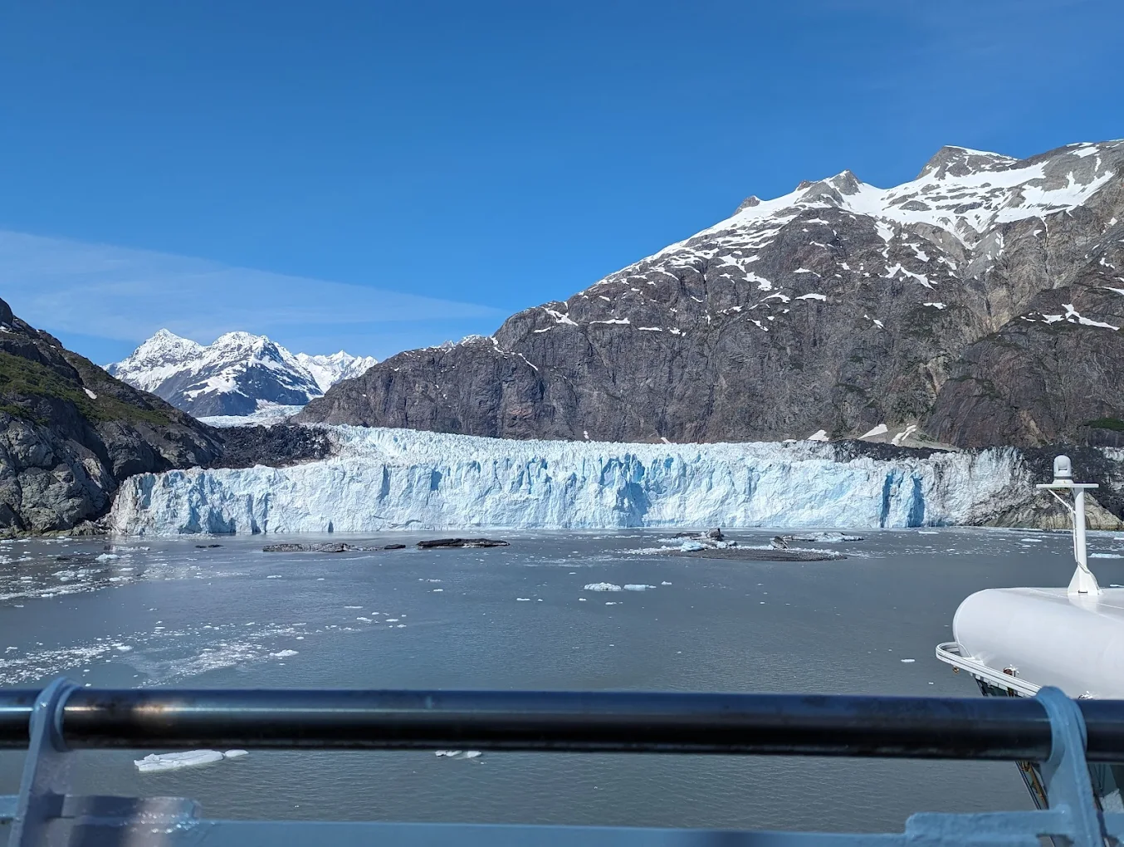
GNSS and Lidar Analysis of Mount Barnard Alaska
Jordyn Fulton
Dr. Luttrell
5/4/2026
GEOL 4002
Spring 2026
Final Project
Image taken by Prash Patel, Retrieved via Google 2026

Slide 2
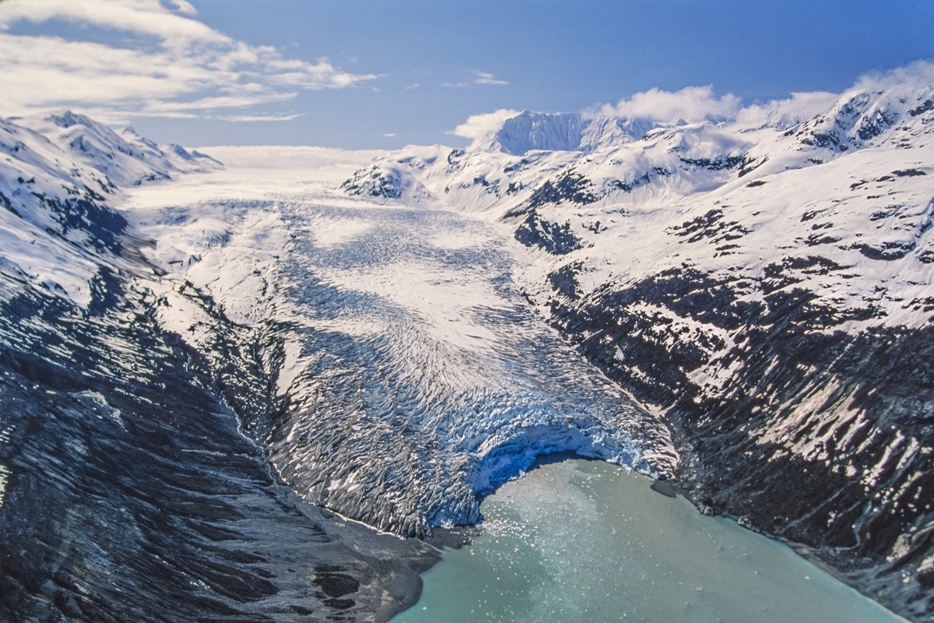
OVERVIEW
INTRODUCTION METHOD
RESULTS
CONCLUSION
Image retrieved from https://peakvisor.com/park/glacier-bay-national-park.html#gustavus-alaska

Slide 3
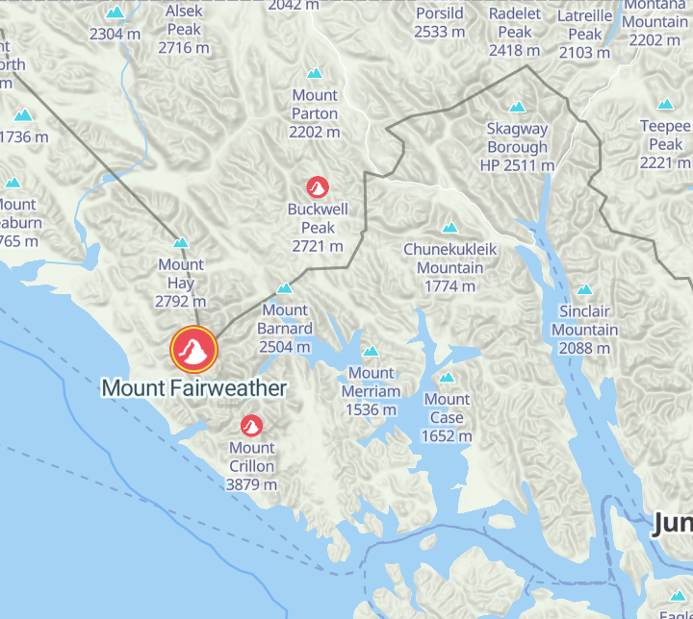
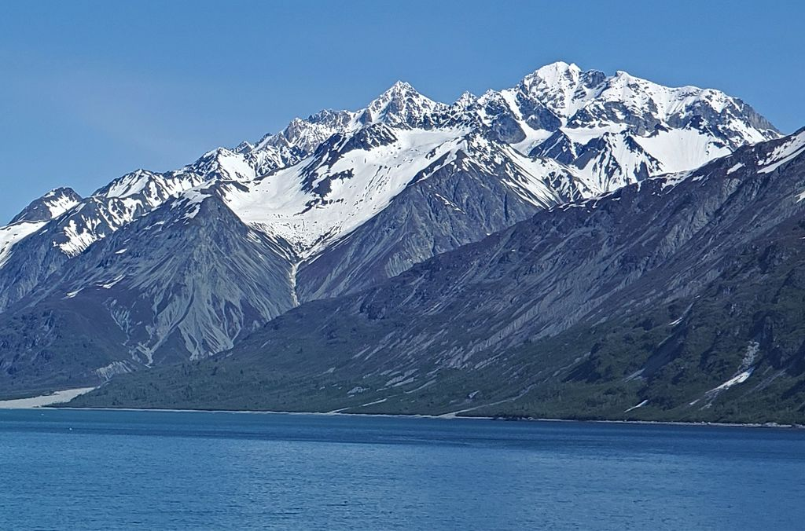
Mount Barnard, AK
Location: Glacier Bay National Park, Alaska near Gustavus
Peak height: 2504 m
INTRODUCTION
Image retrieved from https://peakvisor.com/park/glacier-bay-national-park.html#gustavus-alaska
Image retrieved from https://peakvisor.com/park/glacier-bay-national-park.html#gustavus-alaska

Slide 4
How has the surrounding glacier changed over time?
How is that change reflected with LiDAR and GNSS data?
SCIENTIFIC QUESTIONS

Slide 5
Method to see change:
Comparing topographic digital elevation models (DEMs) from two separate surveys
Normalizing GNSS time series data of two stations to see seasonal loading and unloading
Plotting station velocity vector on a map of Alaska to see the direction the two stations moved over time
METHODS

Slide 6
Anticipated Results
METHODS
01
The DEMs should not look identical since the ice should experience periods of melting and refreezing that would change elevation.
02
The time series should fluctuate with seasons but average out annually if change is minimal.
03
If the glacier is receding, the northern station will move to the north, and the southern station should mover to the south

Slide 7
RESULTING FIGURES
Chosen Stations
BMCP - GNSS data collector Located in the South portion of Glacier Bay
QUIC - GNSS data collector located in the Northern portion of Glacier Bay
Initial LiDAR - AW3D30 - LiDAR Survey from 1/2006 to 1/2011
Final LiDar - COP30 - LiDAR survey from 1/2011 to 7/2015
METHODS
Figures 1 and 2:
GNSS station data over span of 2006 to 2026
Residual GNSS data
Figure 3
Station velocity vectors plotted on map of Alaska
Figures 4 and 5
Initial and final 2D digital elevation models
Figures 6 and 7
Initial and final 3D digital elevation models

Slide 8
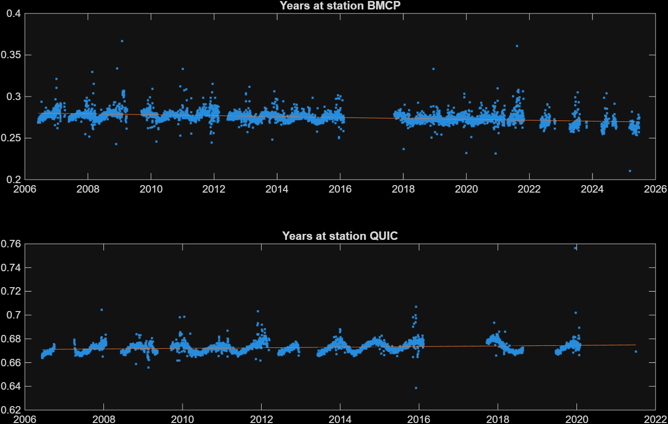
TIMESCALE + RESIDUALS
Station Time Series

Slide 9
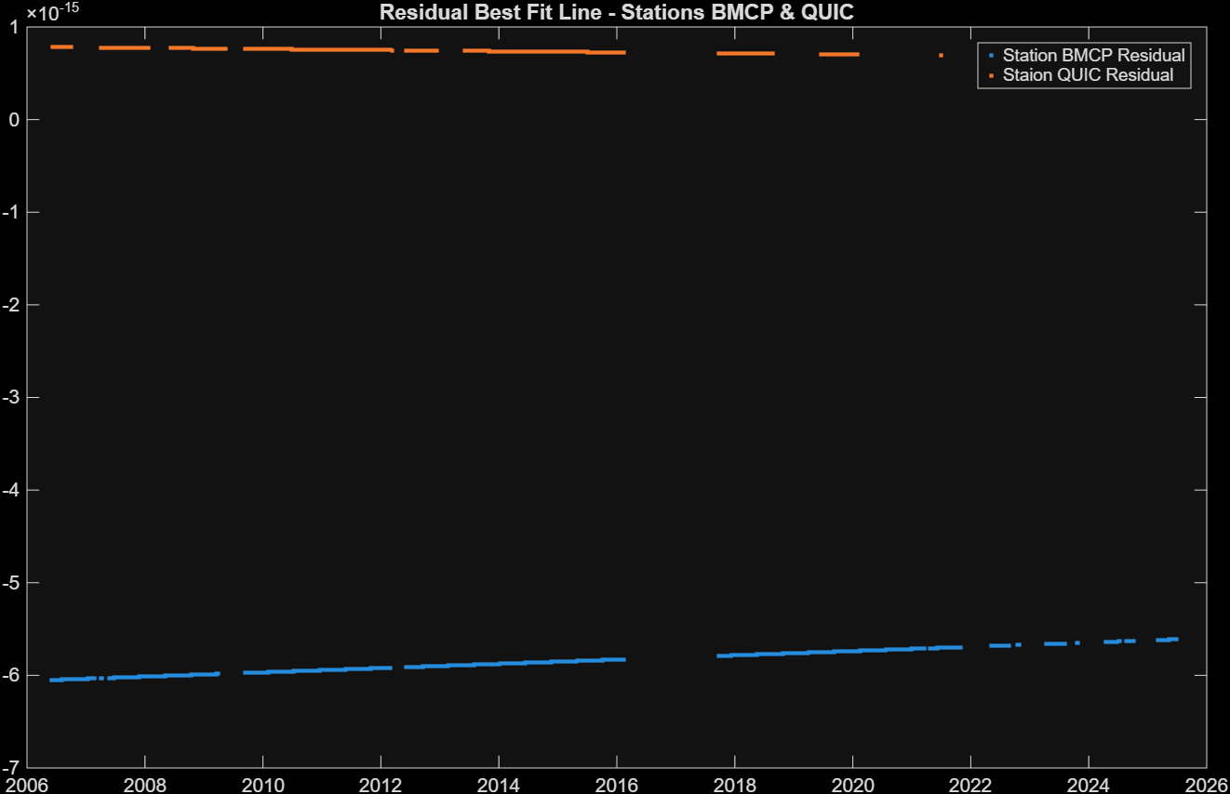
TIMESCALE + RESIDUALS
Station Time Series Residuals

Slide 10
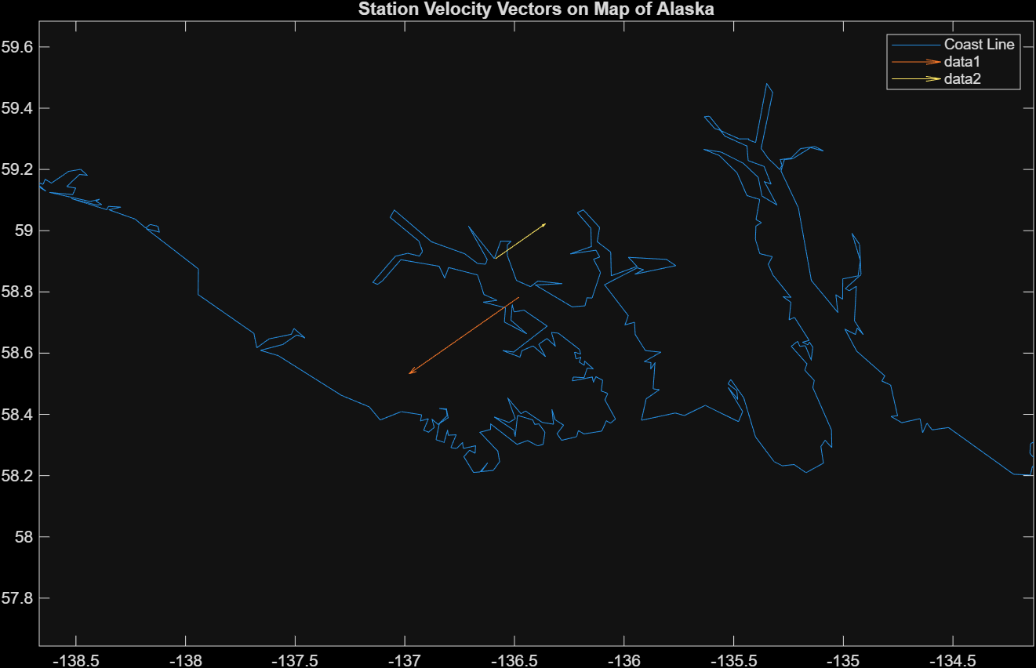
Station Position Change Velocity Vectors on Map of Alaska
Data 1- Station QUIC
Data 2- Station BMCP
Southern Station
RESULTS
Northern Station
Objective 4

Slide 11
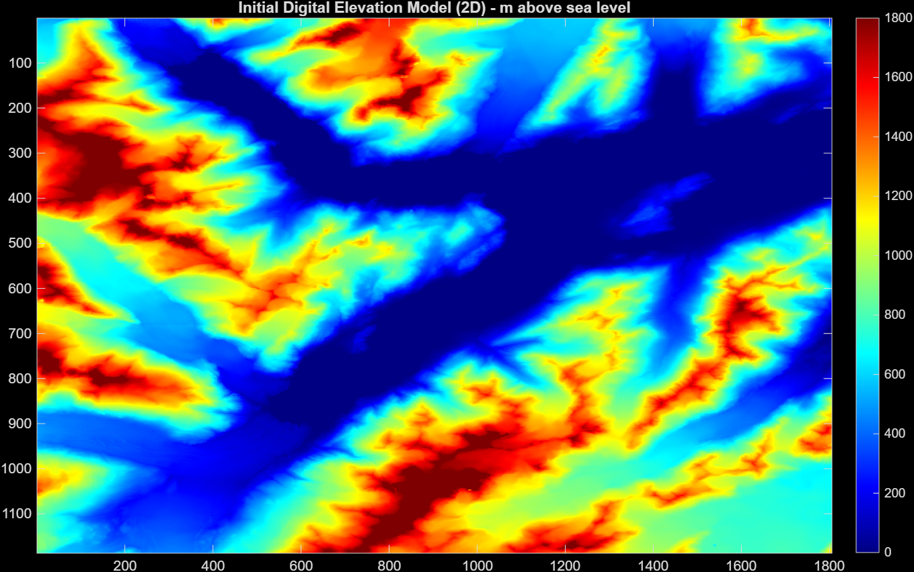
DEMs
2D
initial
RESULTS
20XX objective
INITIAL DIGITAL ELEVATION MODEL - 2D
DATA FROM OPENTOPOGRAPHY

Slide 12

DEMs
final
2D
RESULTS
FINAL DIGITAL ELEVATION MODEL - 2D
DATA FROM OPENTOPOGRAPHY

Slide 13
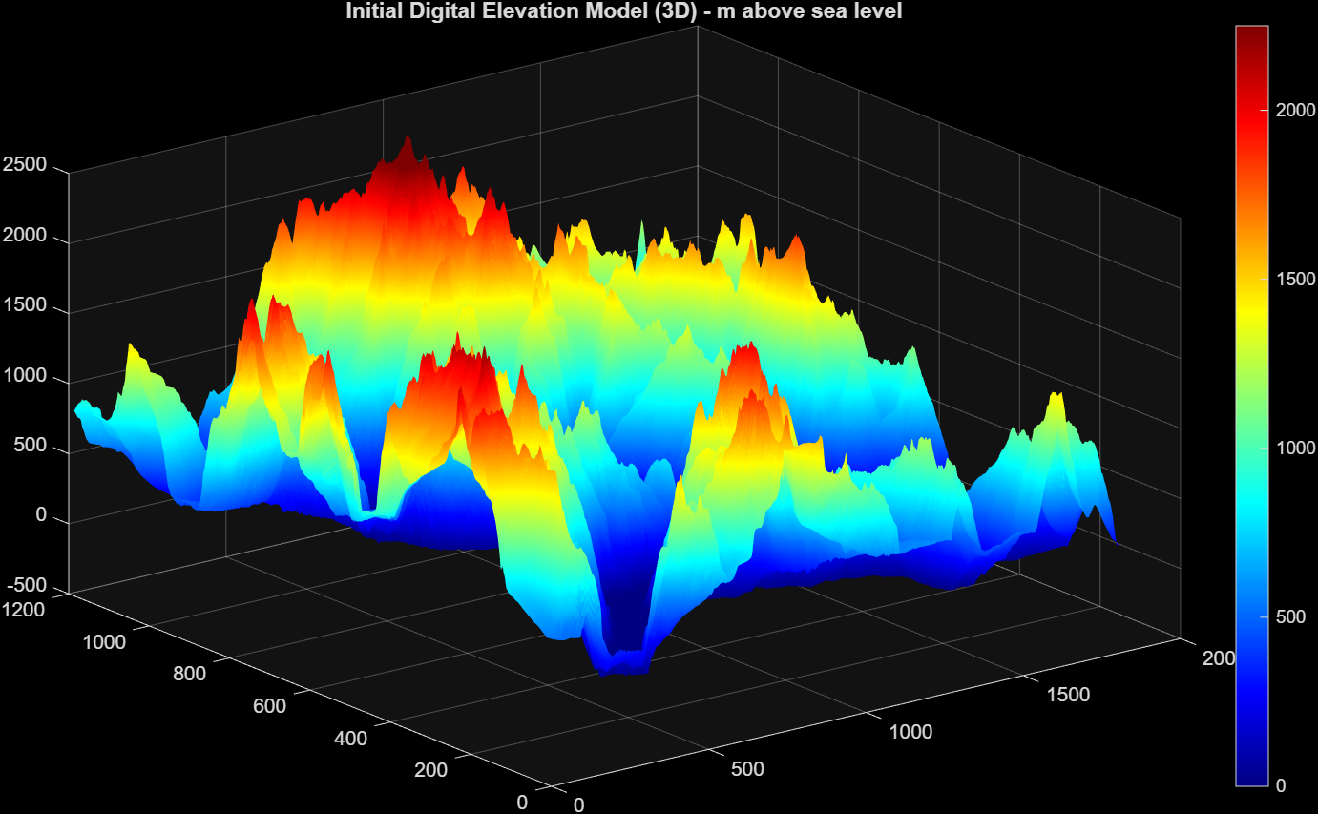
DEMs
3D
initial
RESULTS
INITIAL DIGITAL ELEVATION MODEL - 3D
DATA FROM OPENTOPOGRAPHY

Slide 14

DEMs
3D
final
RESULTS
FINAL DIGITAL ELEVATION MODEL - 3D
DATA FROM OPENTOPOGRAPHY

Slide 15
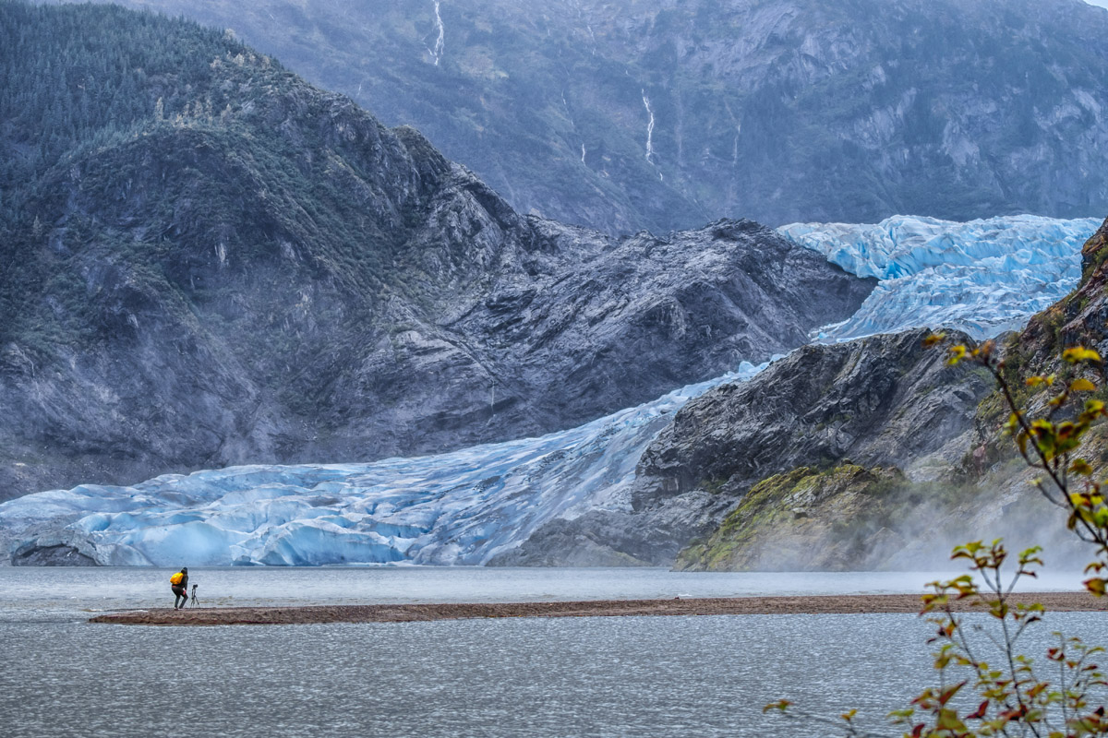
Conclusion
Annual Station Change in Ice over 20 years
CONCLUSION
We can observe glacier change even if its minor!
We want to make sure the glaciers are growing back the ice they melted at a balanced rate. When the glaciers melt faster than they can refreeze, we have to worry about how local communities will be affected by the subsequent sea level rise.
Image retrieved from https://peakvisor.com/park/glacier-bay-national-park.html#gustavus-alaska
But this glacier is doing ok so we don’t have to worry yet!
Station BMPC- -0.2780 m
Station QUIC- +0.1263

Slide 16
THANK YOU!!!
Sources:
https://eos.org/research-spotlights/glaciers-rise-and-fall-and-melt-with-tides
https://www.septentrio.com/en/learn-more/insights/gnss-cold-climate
https://peakvisor.com/peak/mount-barnard-canada.html

